Slide 1
FedDisco: Federated Learning with Discrepancy-Aware Collaboration
Shanghai Jiao Tong University, Carnegie Mellon University, Shanghai AI Laboratory
ICML 2023

Slide 2
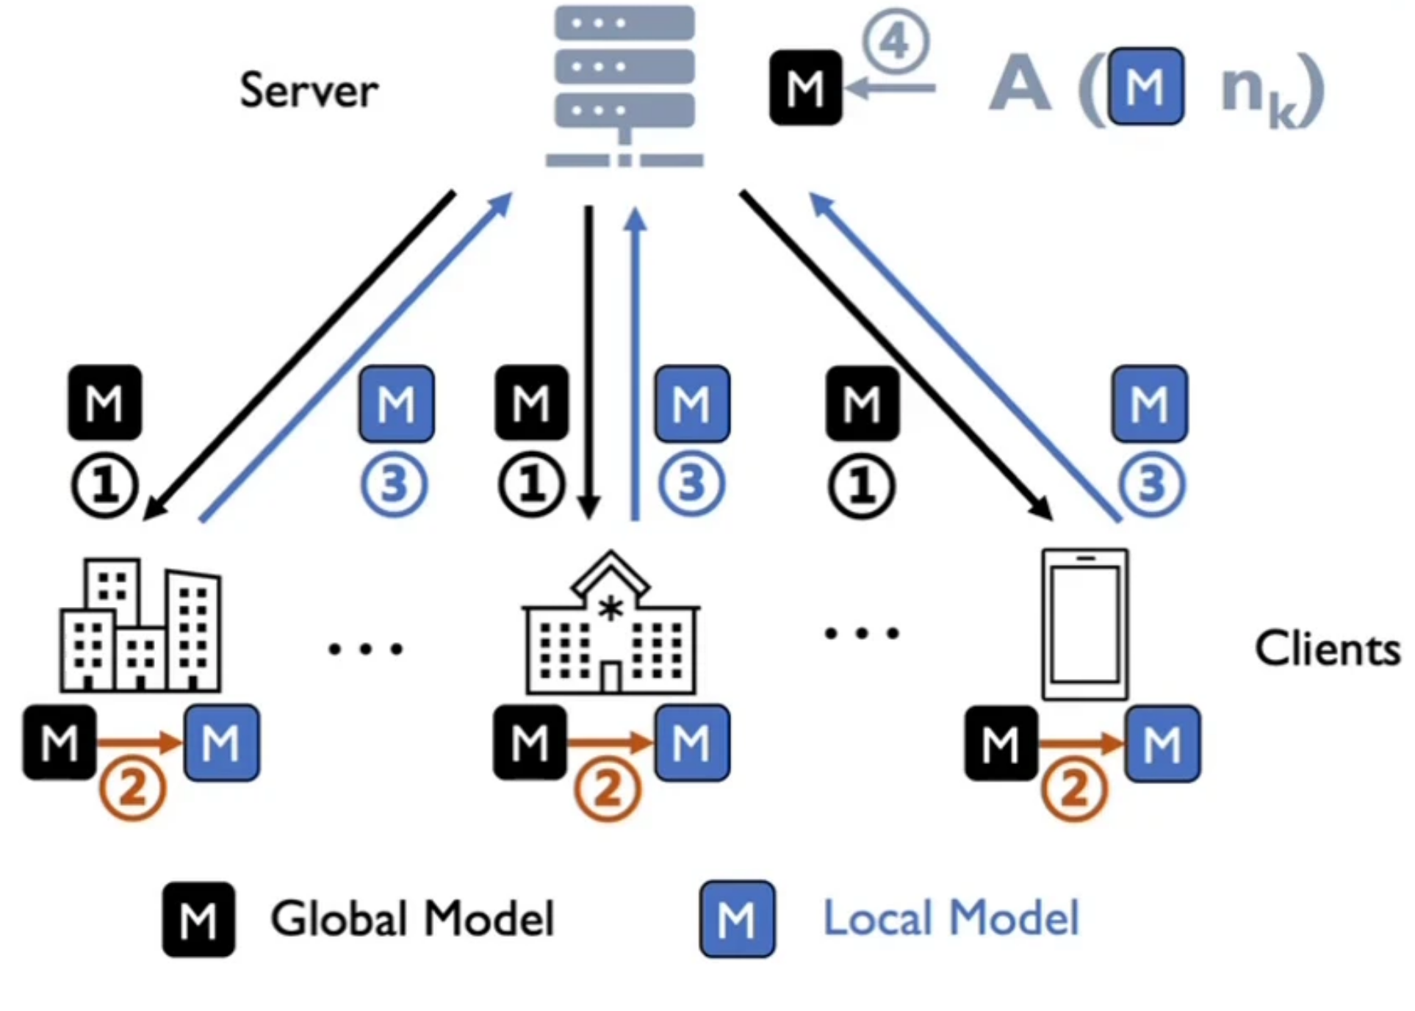
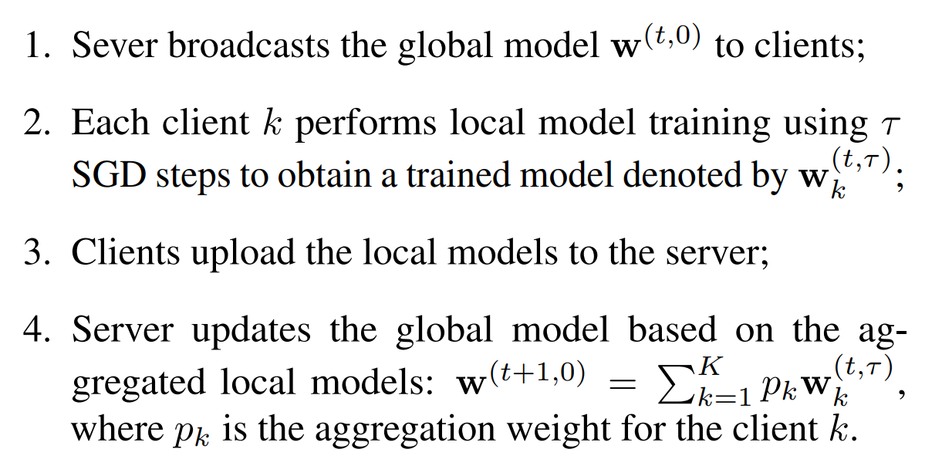

Slide 3
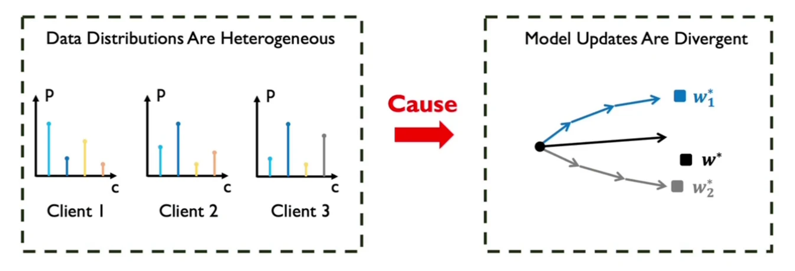
local model adjustment at the client side:
FedProx and FedDyn introduce regularization terms between local and global model
MOON aligns intermediate outputs of local and global models.
ii) global model adjustment at the server side:
FedDF and FedFTG introduce an additional fine-tuning step to refine the global model.

Slide 4
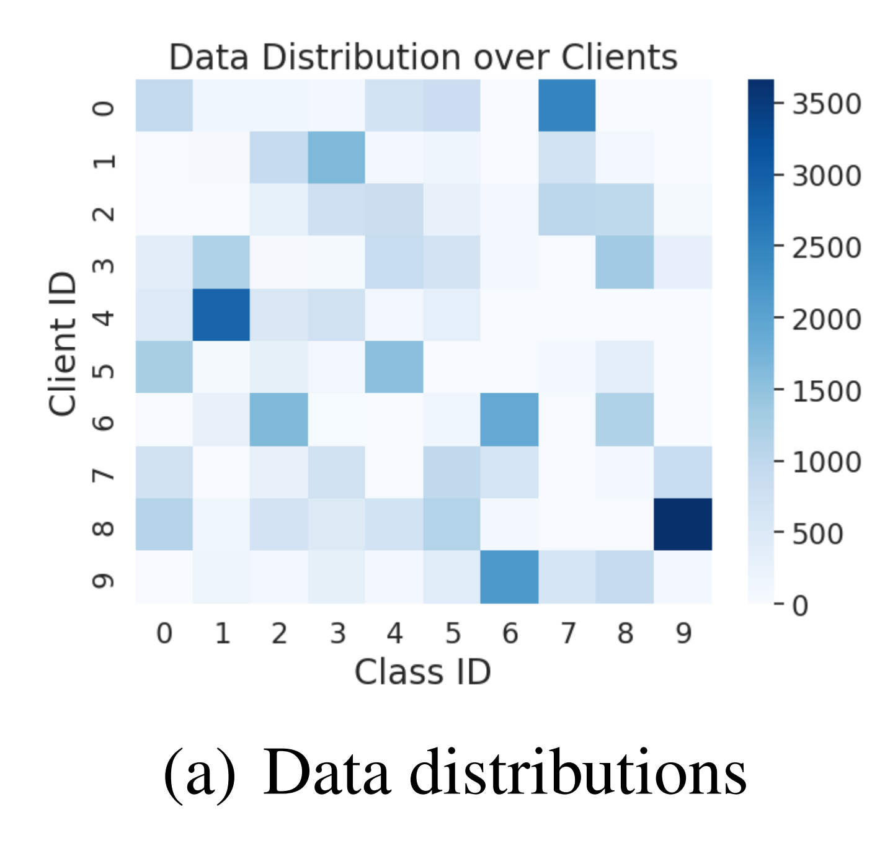
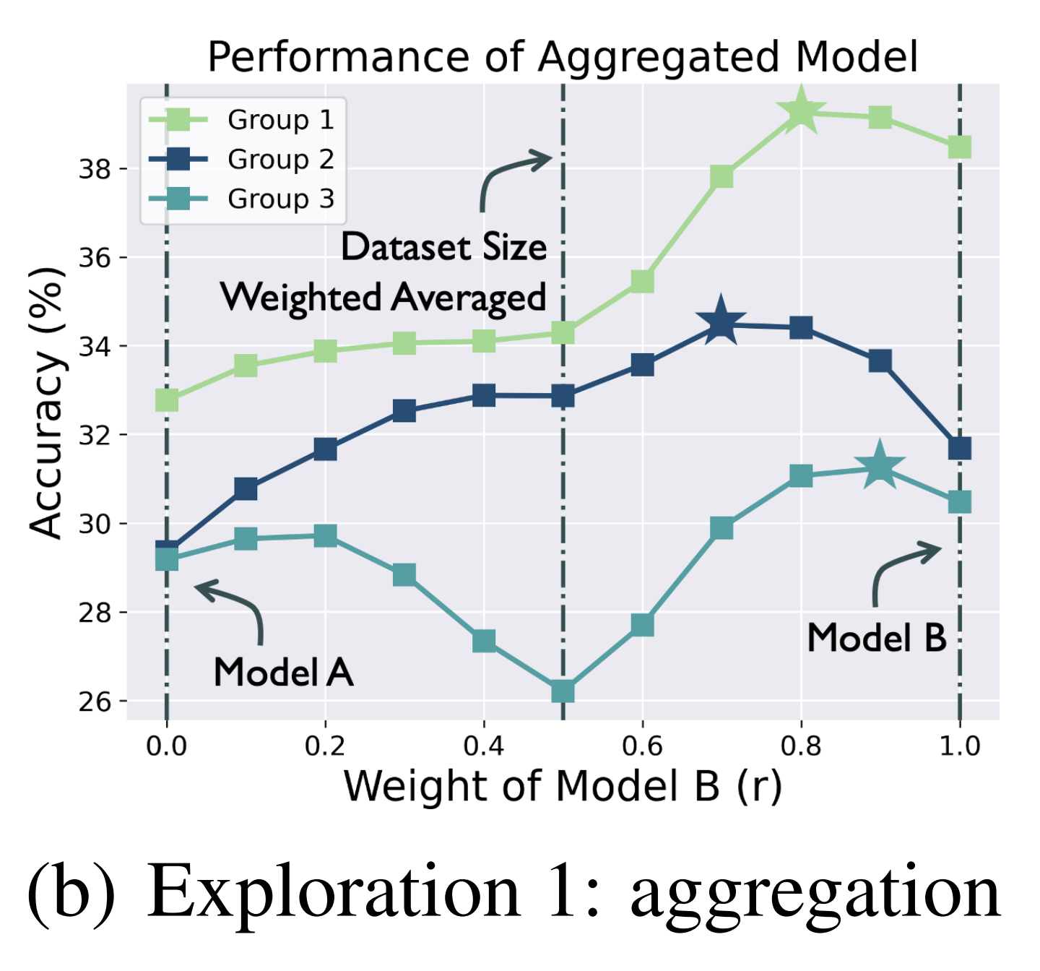
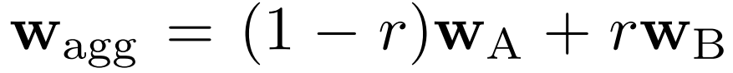
It is not optimal to determine aggregation weights purely based on local dataset size.
Best performance is achieved when assigning a relatively larger weight r to a better-performed local model.

Slide 5
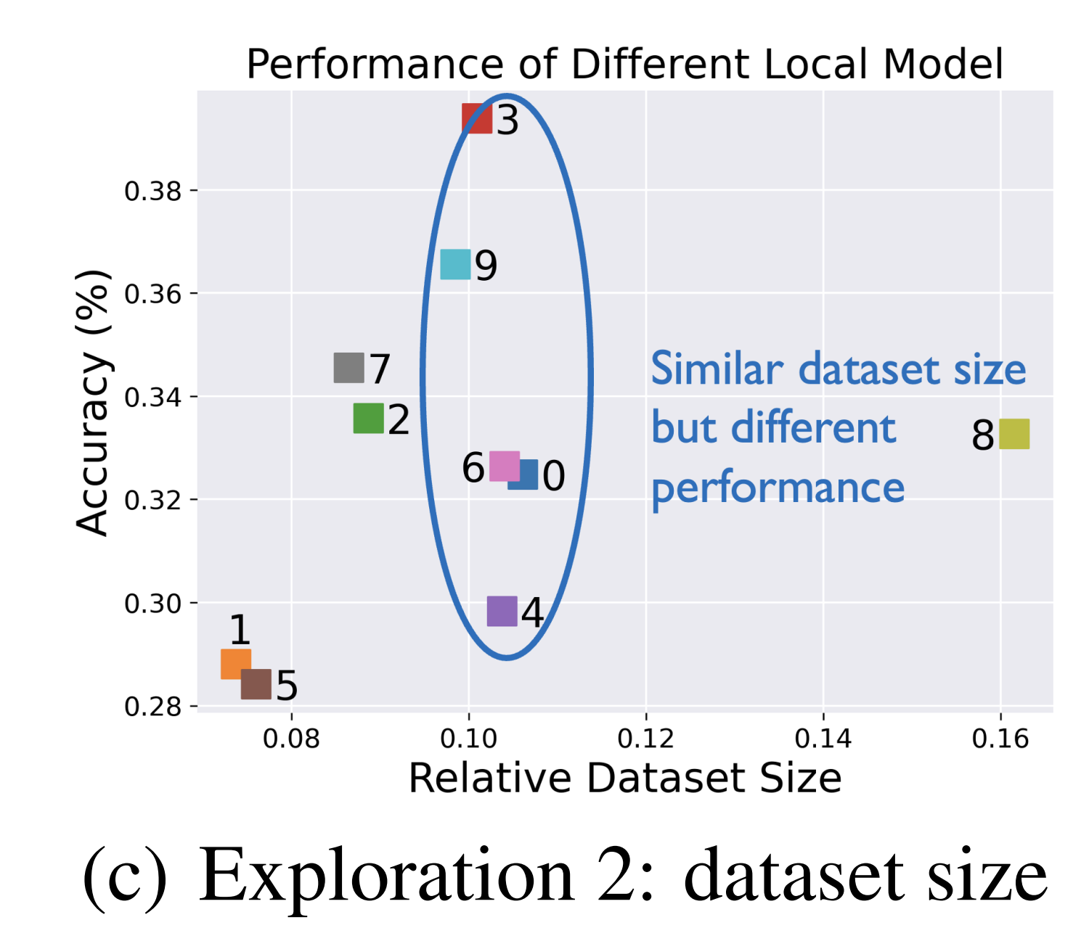
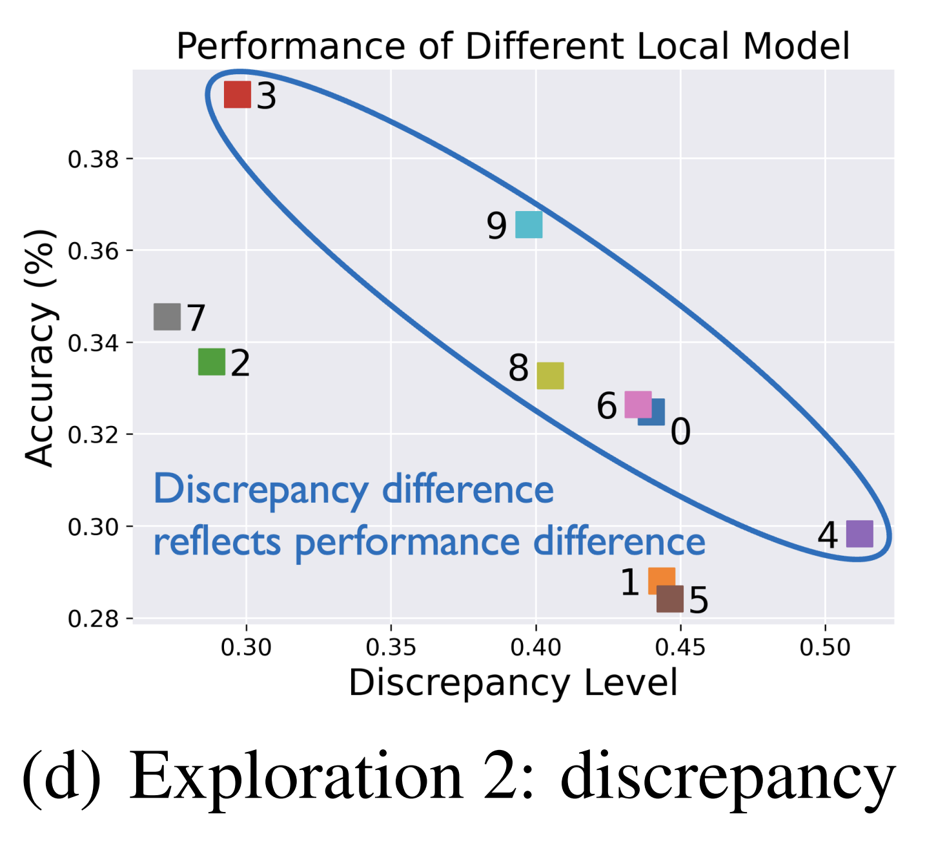
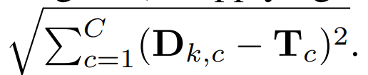
Highlight the clients in a circle, which have similar dataset sizes.
The discrepancy between local and global category distribution.
The discrepancy level is a better indicator to reflect the local model’s performance than the dataset size

Slide 6
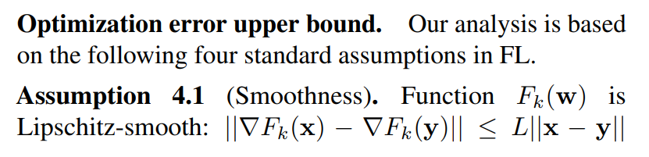

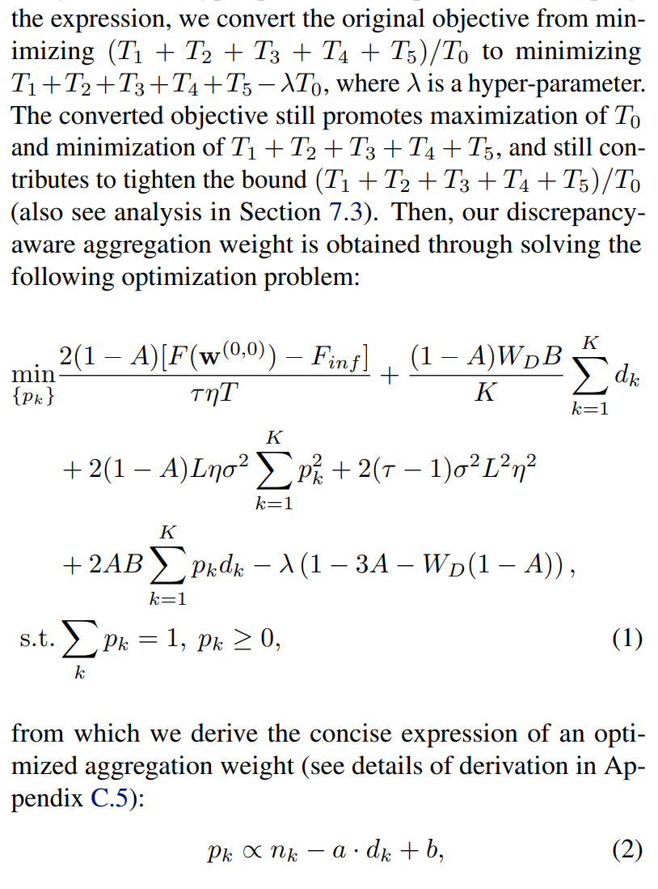
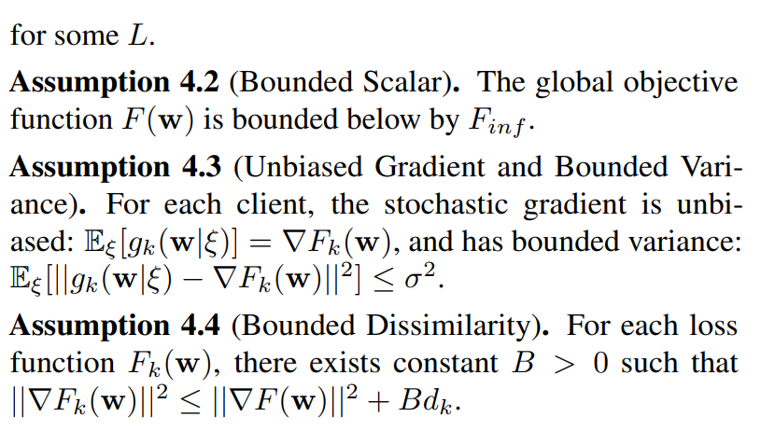
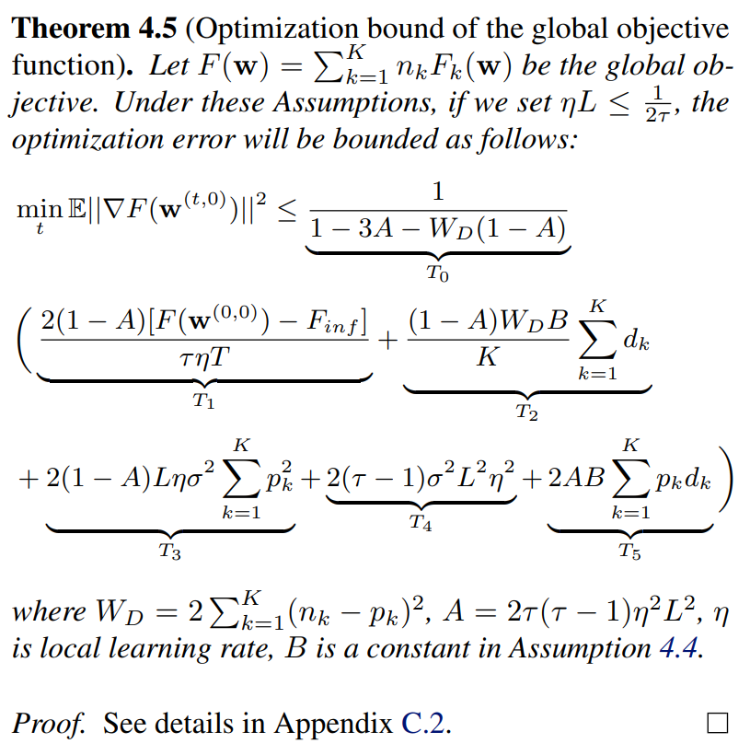

Slide 7
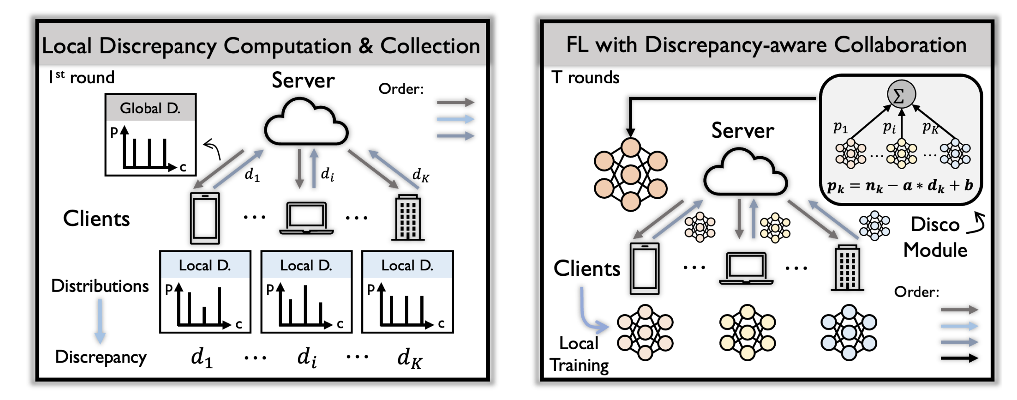
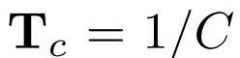
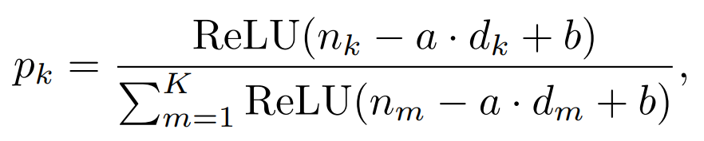
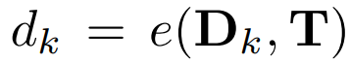
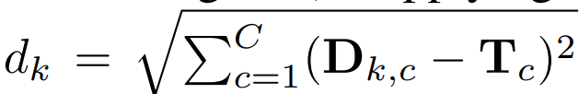
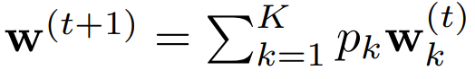
Privacy
Computation efficiency
Modularity

Slide 8
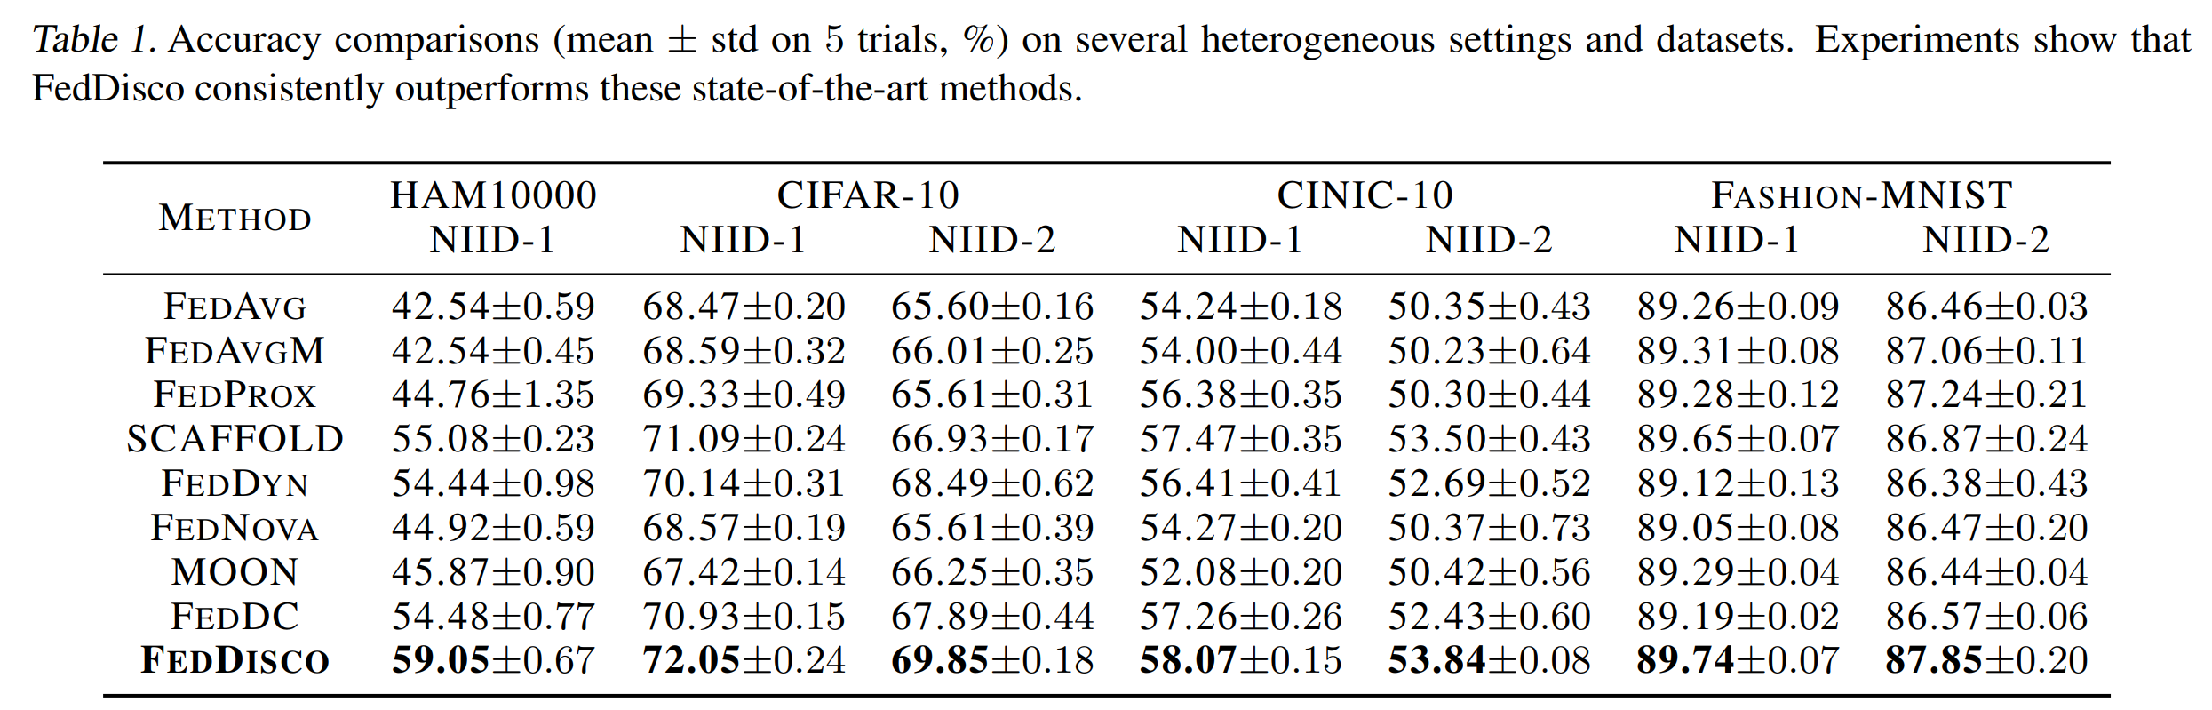
NIID-1 follows Dirichlet distribution Dirβ, where β (default 0.5) is an argument correlated with heterogeneity level. We consider 10 clients for NIID-1.
NIID-2 is a more heterogeneous setting consists of 5 biased clients (each has data from C/5 categories) and 1 unbiased client (has all C categories), where C is the total category number.

Slide 9
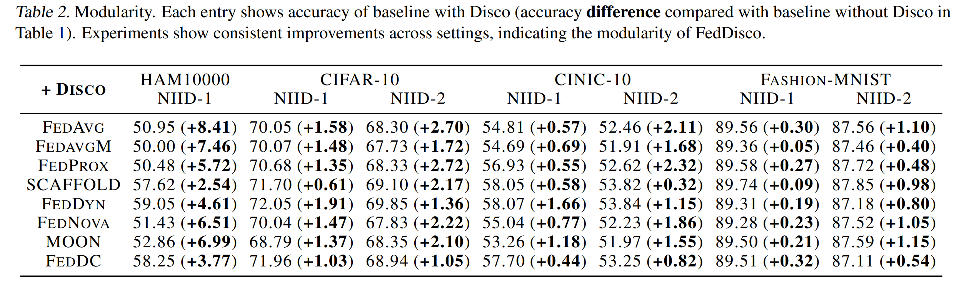
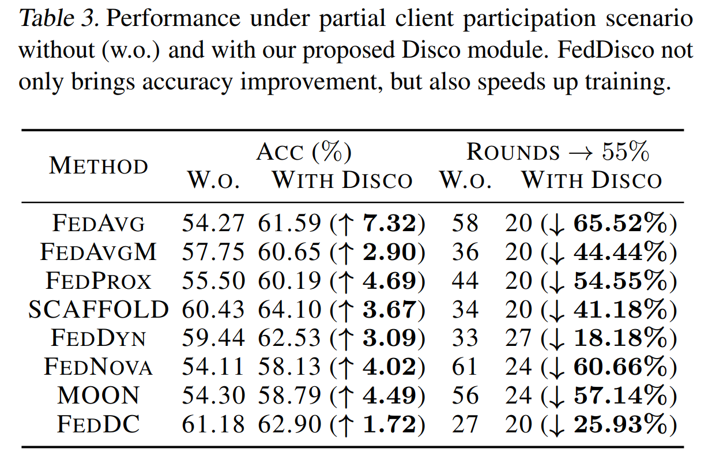
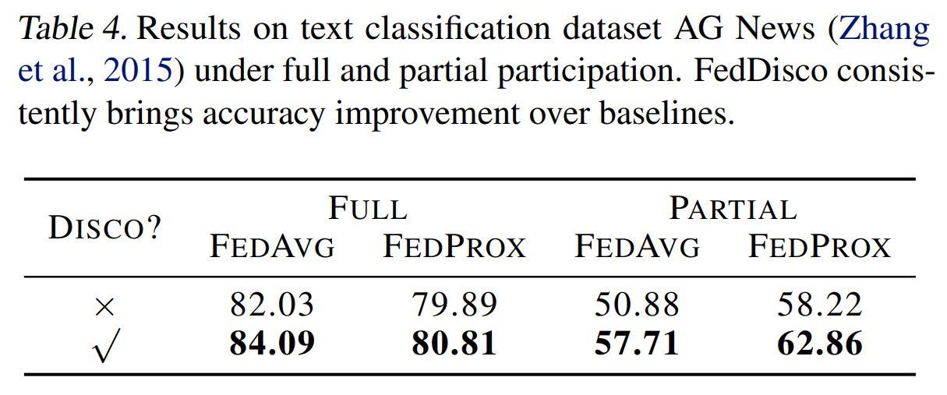

Slide 10
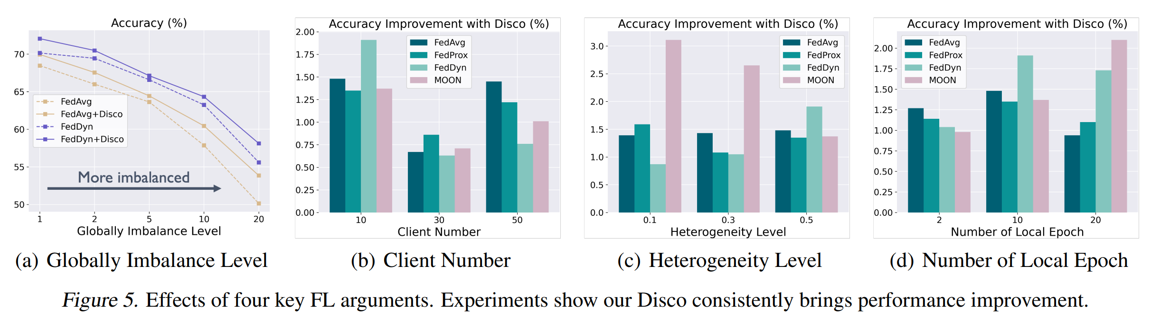
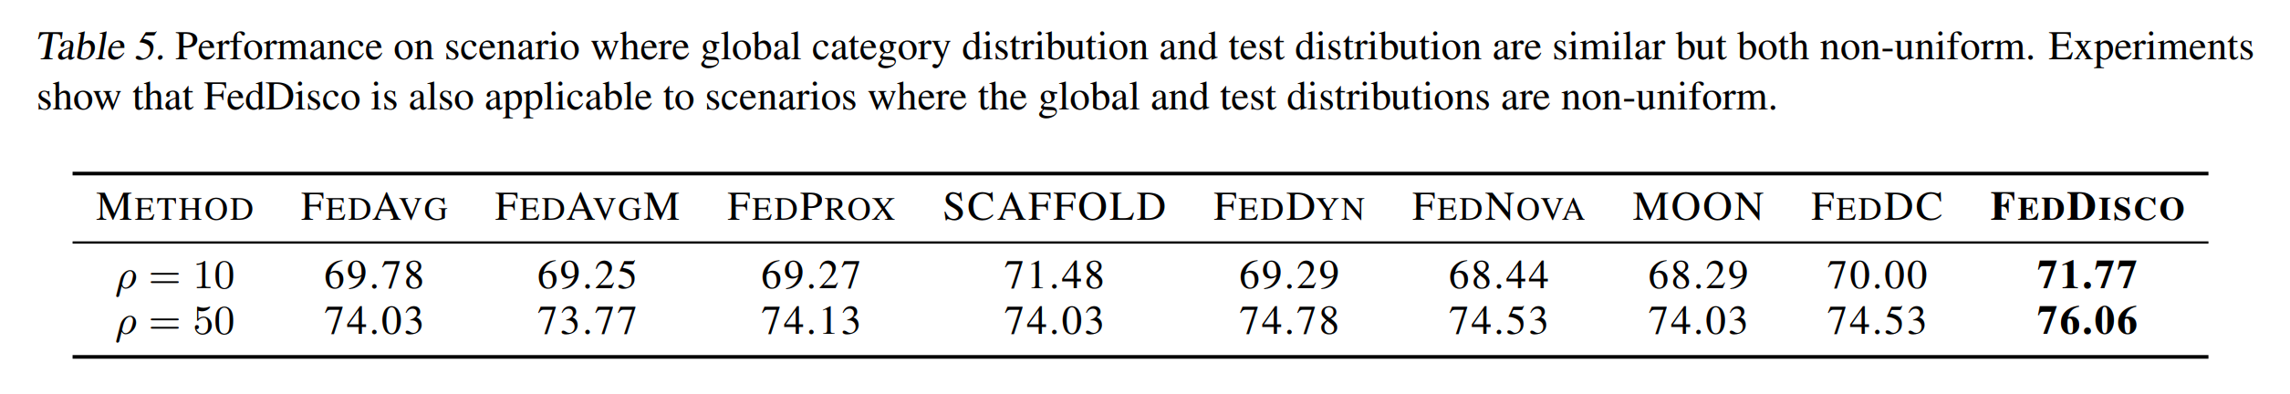
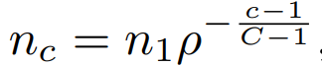
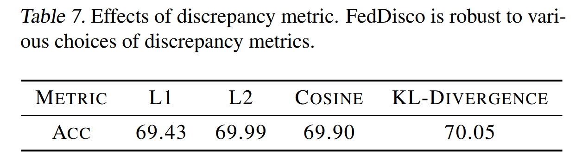

Slide 11
